Slide 1
Romance And Action Reader Trends by Nicole Haibach
Notes:
Introduce yourself: Share your name, educational background (Master’s in Data Analytics), and your passion for data-driven storytelling.
Mention your project’s focus: Analyzing book genres to understand reader engagement and satisfaction

Slide 2
What Are We Trying to Solve?
The research sought to determine whether there is a statistically significant difference in average rating scores and number of reviews between the two genres.
The hypothesis proposed that Romance books have higher engagement (measured by reviews) but comparable ratings to Action books.
Notes:
Problem Statement: Compare the performance of Action and Romance genres in terms of average ratings and number of reviews.
Hypothesis: Romance books have higher engagement (more reviews) but similar ratings compared to Action books.
Why it matters: Understanding these trends helps publishers and authors make informed decisions about content and marketing strategies.

Slide 3
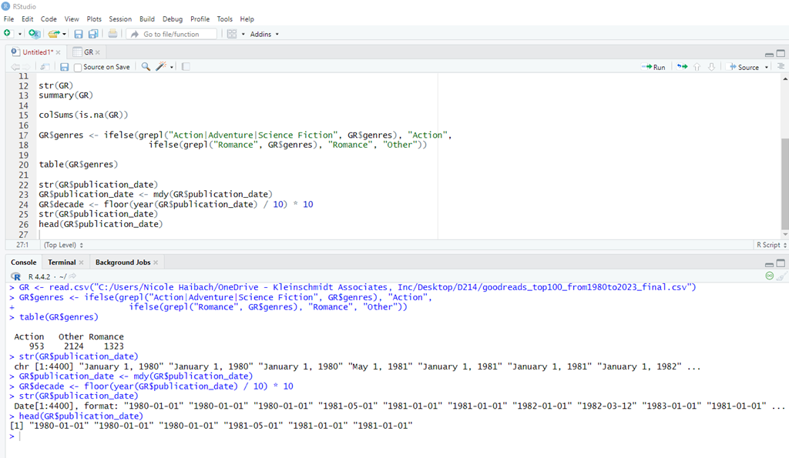
How Did We Analyze the Data?
Step 1: Collected data from Goodreads, focusing on books from 1980 to 2023.
Step 2: Used descriptive statistics to calculate averages for ratings, reviews, and book counts.
Step 3: Grouped data by decades to explore long-term trends.
Step 4: Conducted statistical tests (t-tests) to validate differences between genres.
Step 5: Visualized results using line graphs and bar charts to make trends more intuitive.

Slide 4
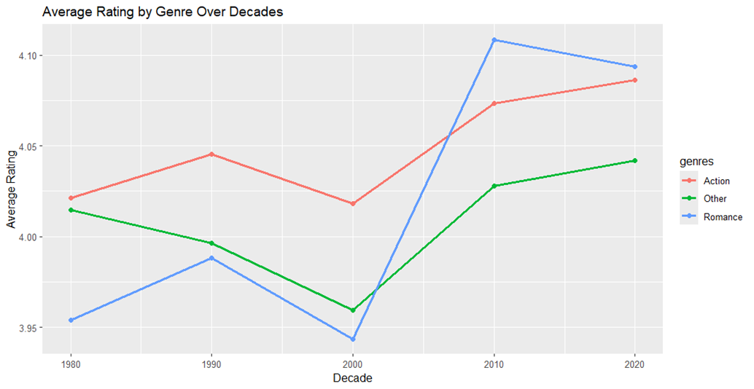
What Did We Discover?
Romance books attract more reviews (average: 11,505) compared to Action books (average: 8,615).
Both genres have similar ratings (Romance: 4.05, Action: 4.04).
Temporal trends show Romance engagement peaking in the 2020s with 23,979 reviews, while Action books peaked in the 2010s at 20,236 reviews.
Statistical tests confirmed the significant difference in reviews (p-value = 0.0008) but not in ratings (p-value = 0.1769).

Slide 5
What Are the Challenges?
Aggregated data may hide individual book outliers or variability.
Dataset is limited to English-speaking Goodreads users, reducing global representativeness.
Statistical tests rely on assumptions like normality, which may not fully hold for all data points.

Slide 6
What Should Be Done?
For Romance Books: Publishers should continue investing in marketing and promotions to maintain high engagement and capitalize on popularity.
For Action Books: Develop strategies to boost visibility and reader interaction, such as leveraging social media or bundling books with similar themes.

Slide 7
How Can This Help?
Publishers: Increased sales by targeting high-performing genres like Romance (average reviews grew by over 150% between 2000 and 2020).
Authors: Create content aligned with reader preferences to enhance engagement and ratings.
Marketers: Use decade-specific trends to design effective campaigns tailored to genre popularity.

Slide 8
Why It Matters
Summary of Findings:
Romance books consistently outperform Action books in reader engagement (average reviews: 11,505 vs. 8,615) while maintaining comparable ratings (4.05 vs. 4.04).
Reader engagement for Romance books has shown dramatic growth over recent decades, peaking in the 2020s.
Impact:
These insights help publishers and authors make data-driven decisions about where to focus their efforts.
Romance books present a strong opportunity for growth, while Action books need enhanced strategies to boost visibility.
Call to Action:
For Publishers: Invest in high-performing genres like Romance.
For Authors: Align content with reader preferences to maximize engagement.
For Marketing Teams: Use decade-specific insights to drive effective campaigns.
Notes:
"Understanding trends in reader preferences allows the publishing industry to better serve audiences while maximizing impact and profitability.“

Slide 9
Thank you

